Slide 1
Reddit Sentiment in Market Behavior
Matt Thurston

Slide 2
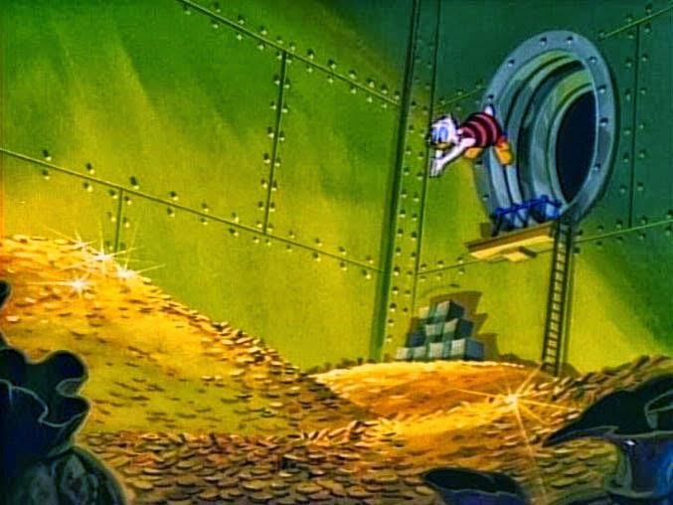
Overview
H-Null: Investor sentiment expressed on Reddit does not correlate with daily movements in stock prices or S&P 500
H-Alt: Investor sentiment expressed on Reddit does correlate with daily movements in stock prices or S&P 500
Process: Measure how positive or negative discussions around specific stocks reflect, or possibly anticipate, market trends
Goal: Get rich like Scrooge McDuck

Slide 3

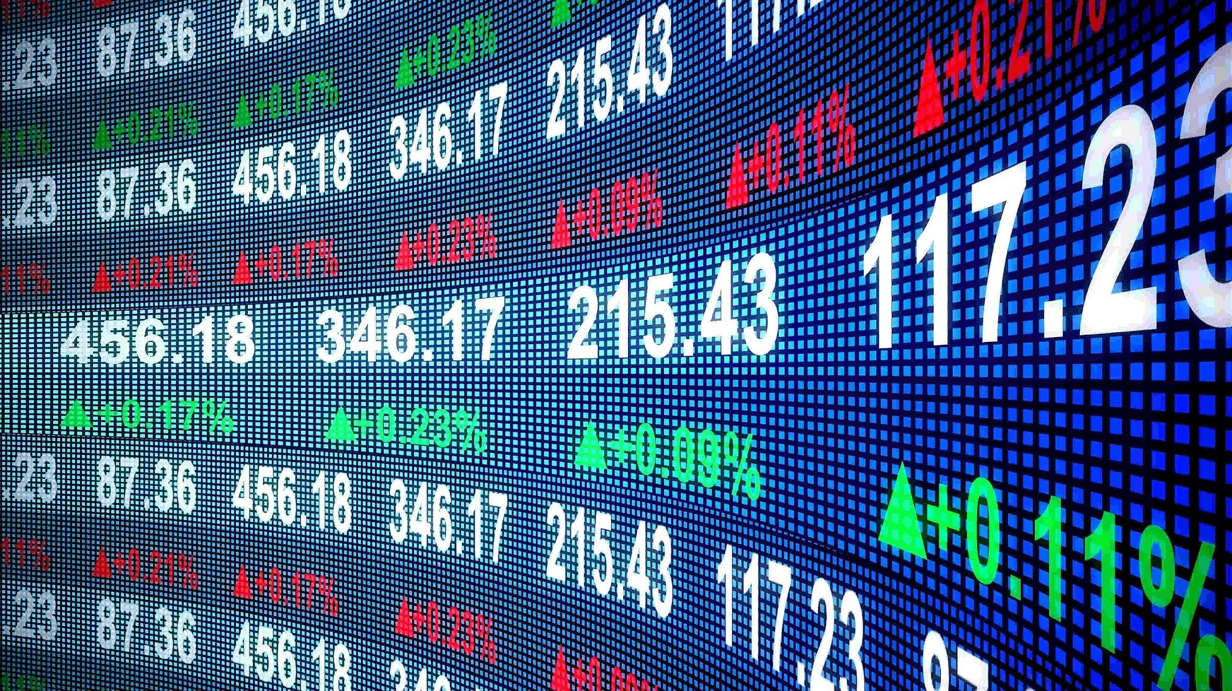
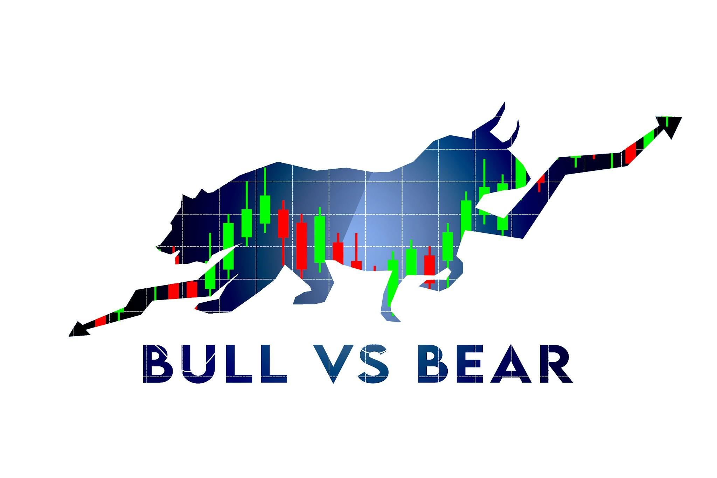
Data
Used RedScrap to collect over 90 thousand comments across 3 different subreddits to gain investor sentiment
Scraped daily Financial Data from investing.com to track stock and S&P performance
r/investing; r/stocks; r/wallstreetbets
Focused in on key words (e.g. S&P 500, AAPL, AMZN, MSFT, NVDA, TSLA)
Used VADER to score and rate sentiment from comments

Slide 4
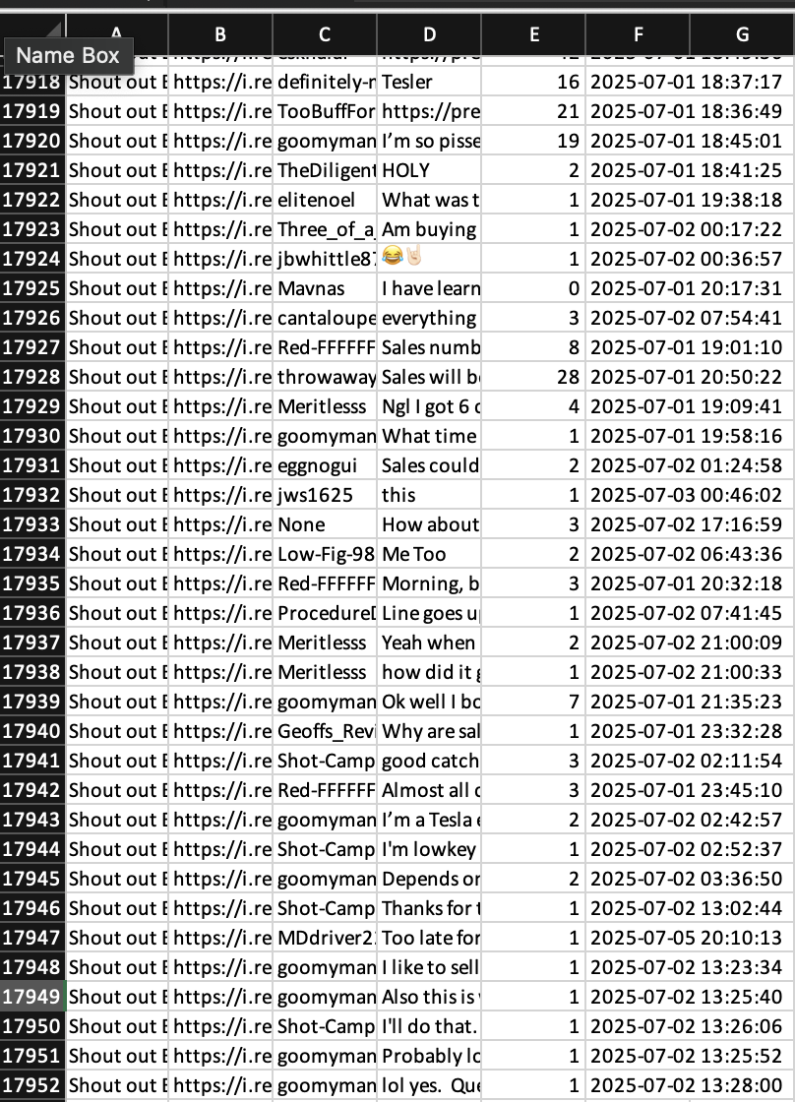
Data Data
I stored cleaned and organized the datasets in CSV/xlsx files, which were later used to generate time-series plots and sentiment trend visualizations
By using the date column from both Reddit and Investing.com data, I was able to align sentiment data with daily stock and index prices, allowing for direct day-to-day comparisons
This alignment made it possible to visualize relationships between investor tone and market movement across multiple stocks
Both text (sentiment) and numeric (price) data were standardized on the same time scale, ensuring consistency across data
Screenshot from Excel of Comments for Tesla just from June-October 15 other files for the other stocks and S&P

Slide 5
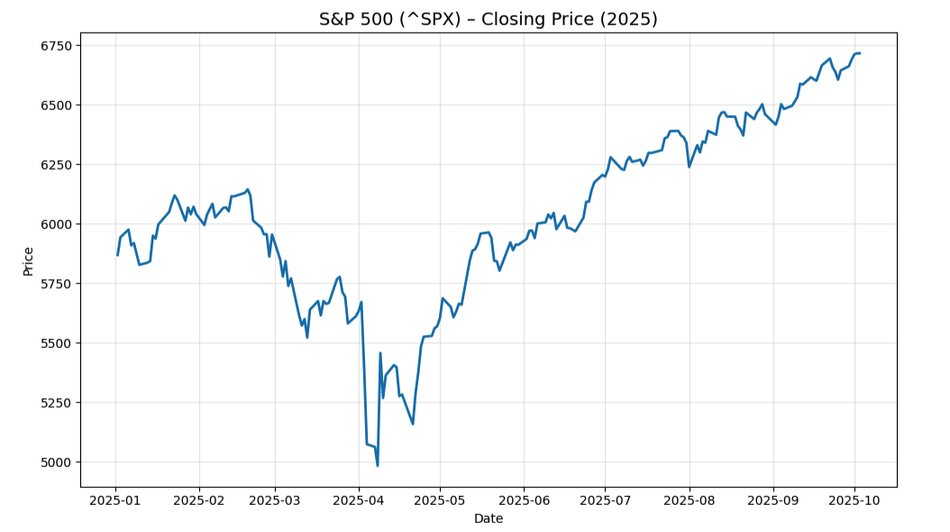
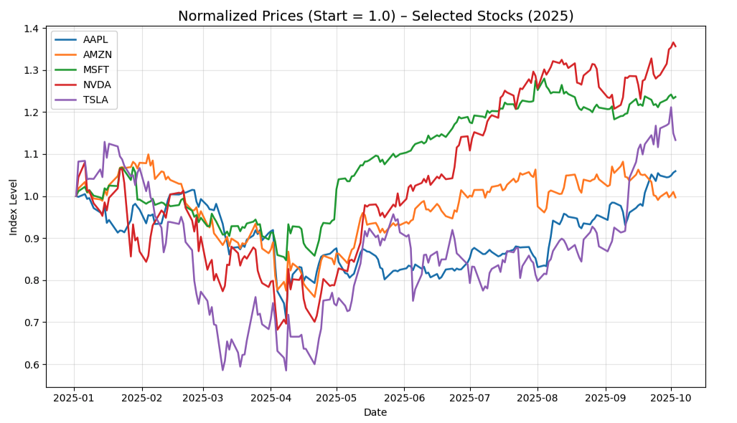
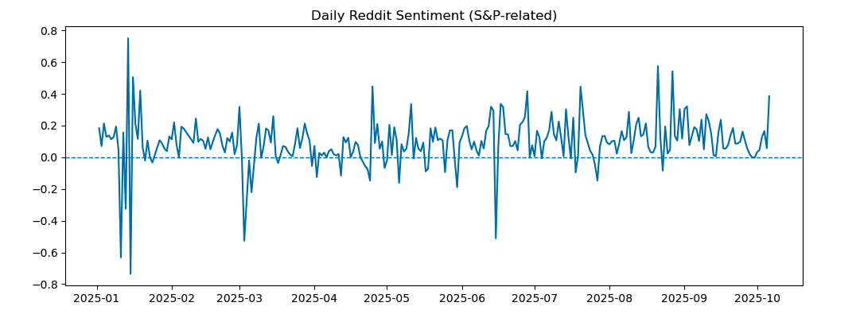
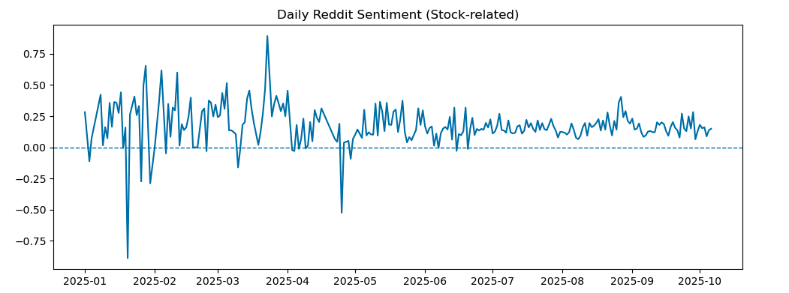
Data Data Data

Slide 6

Issues
Comments sentiment for Stocks are looped in together due to lack of continuance of date.
I could have scraped comments from other sites/threads to give a more concise view of sentiment by investment
Was only able to mass scrape for the current year
If I were to work further on this project I would figure out how to gain access to historical comment data
This would of allowed for a better analysis of effects
I could loop in an event variable that would coincide with sentiment
So rather than scraping data based off the stock itself I could have scraped comments about a new product or promotion
This approach may yield better correlation and could be more confidently used for prediction
There's a lot of “Noise” on these subreddits, if I really wanted to apply this model I would try to limit nonsense comments

Slide 7

Stakeholders Beware, Scare!
Those Possibly Affected:
All investors: If this model proved true those who used it would have an advantage in trading
Companies: I think if this worked in theory with better tech, events like what happened with GME and AMC would happen far more frequently
Me: If it does play a role in the markets, possible SEC involvement, possible insider trading charges
You: Warning! any financial decisions you make based off this presentation, if investigated could lead to investigation
BOO!

Slide 8
Ethical, Legal, Societal Implications.
“Originally developed as part of doctoral research in Pharmacy Practice at Universiti Teknologi MARA, RedScrap follows ethical practices aligned with Reddit’s developer policies. It is published under version v1.0.0 via Zenodo.” - https://github.com/saprimad/RedScrap/blob/main/README_updated.md
VADER (Valence Aware Dictionary and sEntiment Reasoner) is a lexicon and rule-based sentiment analysis tool that is specifically attuned to sentiments expressed in social media. It is fully open-sourced under the [MIT License] (we sincerely appreciate all attributions and readily accept most contributions, but please don't hold us liable). - https://github.com/cjhutto/vaderSentiment/blob/master/README.rst
Questions -
If this type of experiment was done at the max scale with more advanced models, would that still be ethical? What would the effects on the markets be if my hypothesis fails?
Do you think people if people realized how the population acted as a whole online effected their financial investments we would rethink how we use technology in our day to day lives?

Slide 9

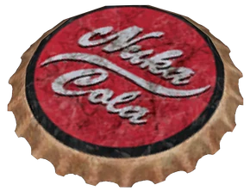
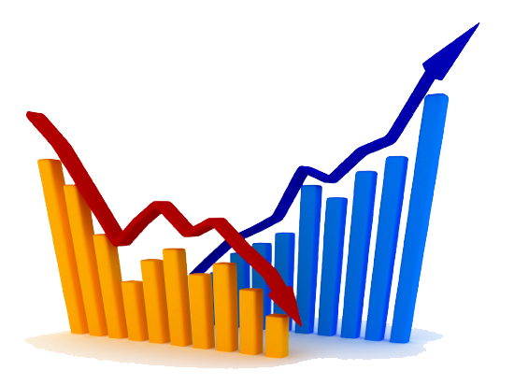

FIN.

Slide 10
Citations:
Tumiran, M. S., Abd Wahab, M. S., Jamal, J. A., & Othman, N. (2025). RedScrap: Python Tool for Netnographic Data Collection (v1.0.0). Zenodo. https://doi.org/10.5281/zenodo.16756945
Hutto, C.J. & Gilbert, E.E. (2014). VADER: A Parsimonious Rule-based Model for Sentiment Analysis of Social Media Text. Eighth International Conference on Weblogs and Social Media (ICWSM-14). Ann Arbor, MI, June 2014.

